Slide 1
Oh, the Humanity!
Kate Gregory
kate@gregcons.com
@gregcons
Notes:
I care a lot about the kind of code we write. Fast, yes. Correct, yes. But also readable, understandable, sensible, pleasant.
I’ve put a lot of work into looking at code and seeing how it could be better. Often making it better by using things we’ve added to C++ this century, or even this decade. Writing code that does the same thing but is clearer or shorter or more transparent or better encapsulated or whatever and looking at the before and after of that code.
In this talk, there’s some code. But it’s not really about the code. It’s about the people who write the code.
I want to start with the title

Slide 2
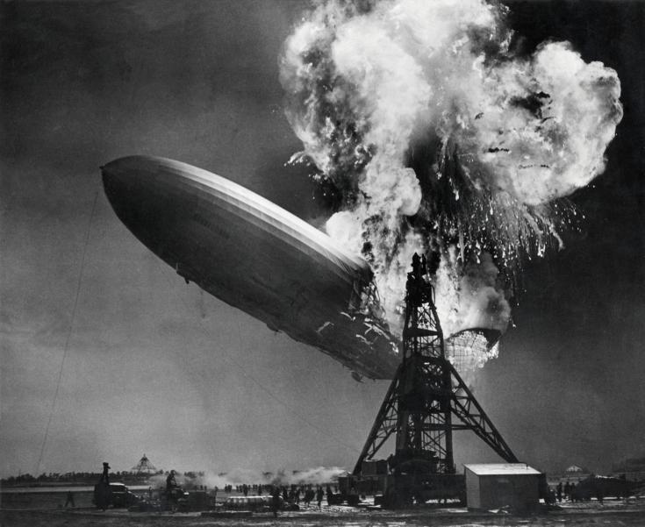
Notes:
By Sam Shere (1905–1982) - Zeppelin-ramp de Hindenburg / Hindenburg zeppelin disaster, Public Domain, https://commons.wikimedia.org/w/index.php?curid=19329337
This is a picture of the Hindenberg disaster in 1937, a zeppelin disaster. Herbert Morrison was recording the first recorded-on-the-spot radio news reporting. It wasn’t live to air, nor was he narrating over pictures. The sound and the pictures were put together in the years since. He was recording to disks that were driven back to the station to be played the next day, which in 1937 was a major big deal. And he had showed up basically to cover an iPhone launch, or a Tesla launch – certainly nothing as a scary as a SpaceX launch, some event where an amazing tech thing was happening and some very glamourous people were involved and it was all “we live in the future” and just marvelous. When suddenly this happened. Dozens of people died and he was upset by that, and having no training on how to stay calm while being recorded unexpectedly witnessing horrible deaths, he didn’t stay calm. He said it was terrible and the worst thing ever and yes, he said “oh, the humanity” while he was straining for words to paint his audience a picture of this terrible awful tragedy that he was obliged to tell them about. He actually stopped the recording a few times to allow him to regain his composure.

Slide 3
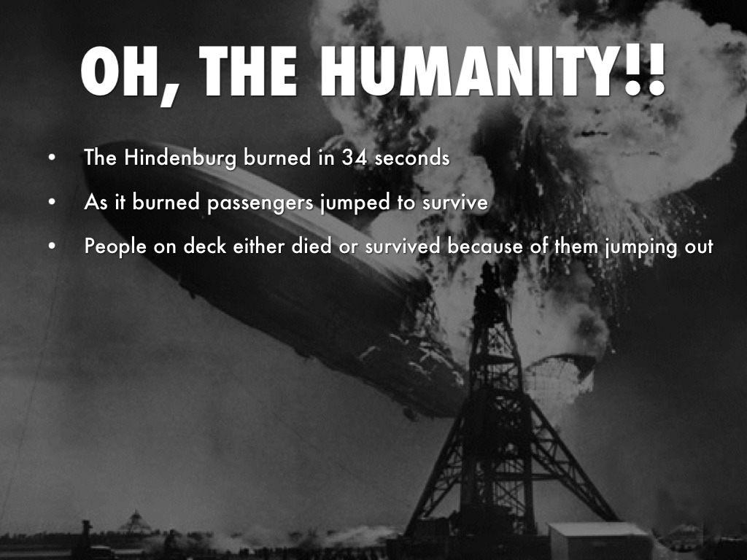
Notes:
Such an iconic image could be used in education material like this, from 2015
https://www.haikudeck.com/the-hindenburg-education-presentation-k66JfJSLQH
But it didn’t take long to get us to this:

Slide 4
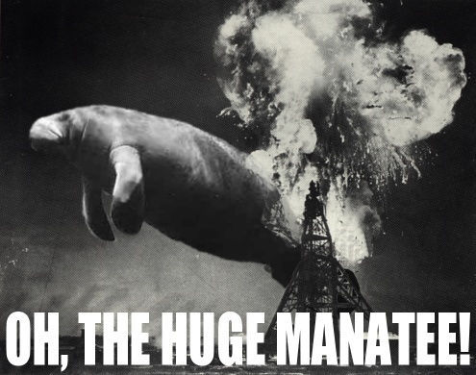
Notes:
https://knowyourmeme.com/memes/oh-the-huge-manatee
an idiom 'used in a satirical way to ridicule, diminish and trivialize emotional displays the speaker deems overly sentimental.'

Slide 5
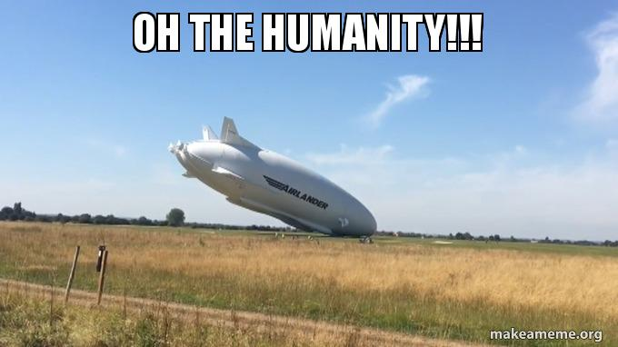
Notes:
And this.
So now whenever someone gets upset and starts to carry on, someone will take them down a peg and be sure to let them know that whatever they are complaining about doesn’t deserve that status. It isn’t a big enough problem for me to permit you emotions over it, my dude. Hey, did dozens of people die a painful fiery death at night in a thunderstorm when everyone thought it was a way cool high tech glamour event? Didn’t think so. Shut up.

Slide 6
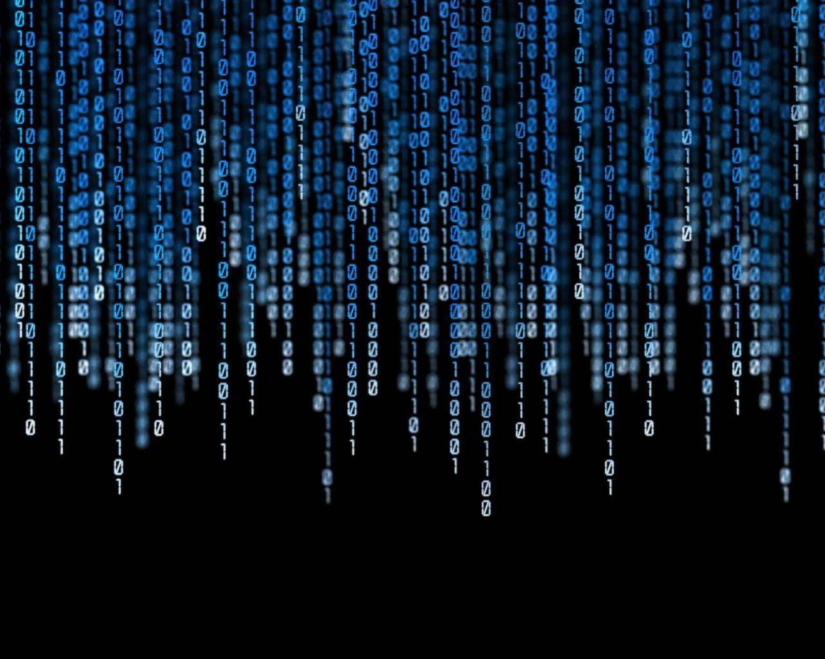
No Emotions Allowed
Notes:
Now, what does this have to do with software development? And specifically with C++ software development, which is what I mostly do?
None of those disruptive out of band interrupts that emotions are. You must win arguments with logic and not with feeling strongly about things. Just the pure crystalline logic of the 1s and 0s of the matrix.
A lot of people really feel this way.
https://wallpapercave.com/w/t8mjzpV

Slide 7
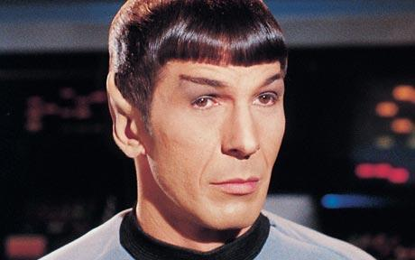
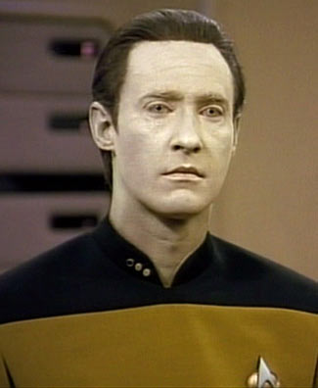
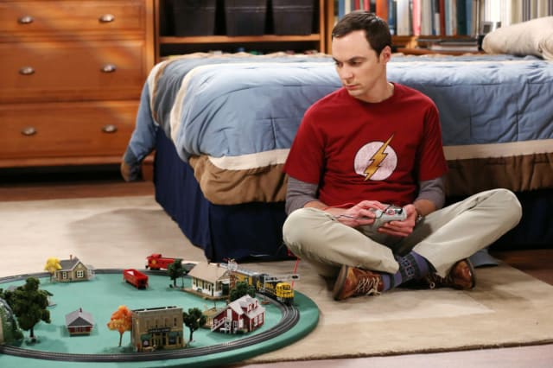
These are fictional characters
Not role models!
Notes:
Spock: http://whatchareading.com/live-long-prosper-peace-long-life/
Data: http://scifi.stackexchange.com/questions/15552/does-star-trek-tng-show-technology-discovered-by-kirks-generation
Sheldon: https://www.cbs.com/shows/big_bang_theory/news/1008904/which-sheldon-cooper-t-shirt-should-you-wear-/
A lot of us try to suppress emotions: in ourselves and in others. Mocking people for their “first world problems” or replying “oh the humanity” to them when they’re getting worked up is our way of enforcing a social norm within the programming community, especially programming communities that have roots in the 20th century rather than the 21st.

Slide 8
Stories We Tell Ourselves
Hard skills are worth more than soft skills
Emotions are for the weak
Code is just logical
I love getting away from people and back to simple pure code
Notes:
Hard skills are worth more than soft skills
Emotions are for the weak
Meetings are a total waste of time
Making software would be so much easier without these pesky users and their illogical demands
Everything is easier without emotions getting in the way
I love getting away from people and back to simple pure code
There’s no messy feelings when it comes to writing code
Code is just logical
Now, there is SO MUCH wrong in all this. We know that software development is a lot more than writing and debugging code, and that the not-code parts of it are FULL of emotion: getting users to tell you what they want instead of what they think they want, trusting your team, telling the truth about your limitations and dreams, being brave enough to go against the stream when you have to, keeping your integrity and values when you find yourself in a place that doesn’t share them, and much more. But I’m not here to talk about any of that today.
I want to focus in on just one myth, just one not-true thing that we all tell ourselves.

Slide 9
There Are No Emotions In Code
There are
I can see them
Notes:
I have been paid to program since 1979, so that’s 40 years. And most of that time, I’ve been reading other people’s code, and my own old code. So you know what I say to that claim? LOL.
And that’s what I’m here to talk to you about today. There’s emotions in your code. Whether you like it or not, whether you know it or not, whether you meant to or not.

Slide 10
Here’s a Little Logic
Programmers are human beings
Human beings have emotions
Therefore…
Programmers have emotions
Emotions are not for the weak: emotions are for people
Notes:
propositional logic, not boolean
But surely these emotions don’t leak into our code? Oh sweeties, they really really do

Slide 11
Fear
//if (m_nCurrentX != g_nCurrentX
// || m_nCurrentABC != g_nCurrentABC) {
//}
Commented out code
I might not be doing this right; I might need this
Comments with who told you to change this
Don’t blame me if this does the wrong thing
Unused variables and code not removed
How can I be sure we won’t need it?
No time taken to clean up
I’m on a knife edge as it is, I can’t take time for that
Follow the same bad patterns that were there
I can’t stand up for doing it differently or better
// int nData; 3/22/03 uninitialized catch by VC7
int nData = 0;
int c,n;
int r1,r2,r3,r4;
double factor;
double pct1,pct2,pct3,v1,v2,v3,v4,v5;
double d1,d2,d3;
Notes:
The first example is a semi tricky “if” comparing the member variable values of things to some global values with similar names. That’s apparently no longer necessary, but the developer can’t bring themselves to throw it away. They aren’t sure they could get it back if they needed it again.
Second example from over 15 years ago is someone justifying why they’re initializing a variable. This is from live code still maintained today.
I’m including a few examples at first but not for everything – you’ve seen your share of this sort of code in the past, I’m sure.
One huge cause of fear, by the way, is crunch. Crunch makes everyone terrified that deadlines will be missed or projects will fail or teams will all be fired, and that makes people do everything the quick way even when they know it’s not how they should be doing it.

Slide 12
Fear
Checking what doesn’t need to be checked
I can’t be sure I’ll be looked after
Checking again and again
I can’t remember if I did or not, I can’t count on it
That was in a team-mate’s code, they might have changed it without telling me
Doing everything by hand
I need to see it, step through it
I can’t trust anyone else’s code
I’ve been hurt before
if (pPolicy) { delete pPolicy;}
Notes:
There’s so much fear in code I needed another slide
Deleting a null pointer is a no-op, it’s harmless, there is no need for this check but I see it all the time
And of course if you’re using delete, you’re probably doing it wrong.
Some of this fear is mitigated by tests. Writing code to see if your team-mates continue to keep their promises is not the most efficient approach

Slide 13
Arrogance
Tiny variable names
Aren’t you smart enough to figure out what these are?
Obscure function names
Why should I explain myself to people who can’t understand it without an explanation?
Deliberately opaque names
foo and bar considered harmful
f(), g(), etc not much better
Raw loops, own containers, own algorithms
In most cases
Perhaps “it ain’t bragging if you can do it” applies
Sneering comments and names
If you say lusers, pebcak, and rtfm in slack, you say it in your code too
void UndoStevesNonsense();
Notes:
Let’s talk about foo and bar for a minute. They come from fubar which comes from snafu. They are navy slang: snafu stands for Situation Normal, All Messed Up. It’s a form of dark humour among those facing death and realizing that the people above them don’t care a whole lot if their stuff is broken or missing or their orders are contradictory. Fubar stands for Messed Up Beyond All Recognition, and takes us beyond Situation Normal into a really dark place. Again, it is the talk of people who are literally facing death under very difficult circumstances. We are writing software, and while many of us are saving lives by doing so, we are not risking ours at the same time. And generally speaking the people above and around you do care if the stuff you have is broken, inadequate or in some other way, messed up. I object to foo and bar not because of the mild swearing – when I don’t have a mike on you’ll hear me swear from time to time – but because of the negative attitude. The miserable attitude. The whole “it doesn’t even matter” attitude. I don’t want to be that person, not even in a little piece of sample code. Because names do matter. They matter a whole lot. And choosing a name that means “ha ha names are stupid and so are you for wanting this thing to have one” is not reasonable.

Slide 14
Selfishness
No time taken to clean up: refactor, rearrange, rename
Why should I spend my time making things easy for you?
Short and opaque names, magic numbers
I’m being measured here, and I’ve got tickets to close
Side effects and consequences everywhere
Public variables because it’s quicker
Mutable global state because it’s quicker
Information Hoarding
My job is safe if nobody else can do this
Notes:
Sees their coworkers as competitors
I don’t have to outrun the bear; I only have to outrun you

Slide 15
Laziness
Whatever, it works
Mostly, enough anyway
No STL, no libraries to speak of
I can’t be learning new stuff, I have code to write
No testing, no build automation, no scripts
If you think that matters, you do it
Copy-paste-edit
Abstraction? Sounds like work to me!
No commitment to the future
Notes:
I mentioned crunch earlier. If you keep a team in crunch indefinitely, they will end up behaving in a way that is indistinguishable from laziness. They literally don’t have time to find out how to do things more quickly. They can’t invest an hour to save a day or a week. Nobody is letting them have the hour. They already aren’t sleeping enough and are keeping track of whose marriage has failed so far on a whiteboard in the common room. I can’t always be sure, when I read code like this, if it came from a lazy person among hard workers or from a crunch time among normal times; though the fact nobody goes back to fix it can be a clue.

Slide 16
Code Shows Emotions
Fear
Arrogance
Selfishness
Laziness
Notes:
So is it true that code is only logic and has no emotions? Well, in some sense it is. You’re given a rule like “if today’s date is after the due date, then the item is overdue and this is how it gets processed.” There’s no emotion to that. But everything else, including the variable and function names you use, whether you make checking for overdue-ness a member function of something, what data type you use for dates and how you test “after”, all of that can and does carry emotion to someone who knows how to read it there.

Slide 17
Why Does This Matter?
Empathy as you read and fix that legacy code
Does your team or workplace need to change?
A lodestar for yourself as you write new code or tidy old

Slide 18
But Can’t Some Code Be Neutral?
Shopping lists can be neutral
Love letters can’t
If they’re not actively warm and loving, they’re cold and disappointing
Letters of recommendation can’t
If they just confirm facts, they scream “bad hire”!
Code can’t either
No in between
And even if there was, why aim for that?

Slide 19
No Neutrality
Choose to Be
Instead Of
Confident and capable
Reassuring and obvious
Open and transparent
Humble
Generous and empathetic
Insecure and afraid
Secretive or slapdash
Information hoarding
Arrogant
Selfish
Notes:
Once you understand that everything you write is lighting up in one or the other of these columns, why not, when you can, take the time and put in the work to show what you stand for and to put yourself on the good side of these lists by putting your code on the good side of these lists?

Slide 20
Look Where You Want to Go
Notes:
Like most Canadians, I’ve been taught how to drive on icy and slippery roads. You can take lessons where you practice going into a skid and recovering. But the best piece of advice for not hitting a tree or a truck or the guardrail or whatever is “look where you want to go”. If you lock your eyes on the thing the car is headed for, you will most likely watch it all the way until you hit it. Instead, look for an opening, a gap, something that’s not a thing to hit, and lock your eyes on that. Your hands and feet, reacting to the feedback from the car, will pretty much do the right thing and get you where you are staring. Your chances are way way better anyway. I’ve done this a few times and it really works.
And of course, it screams out to be taken metaphorically, doesn’t it? Focus on what you want in your code, not on what you don’t want your code to show about you.

Slide 21
Confidence
Delete things you don’t need
I have source control and work notes
Take time to clean up
It might help me, it might help someone else
Comments and names explain thinking
I know I’m right, let me show you
Obsolete or handrolled things replaced
I’m brave enough to stand up for doing things the right way

Slide 22
Humility
Use libraries
Include a link to the doc if it’s not just cppreference.com
Gentle comments
Where things aren’t obvious, leave some help for the next person
Helpful names
For functions, variables, everything
I may not be the best, even though I’m very good
//Set page size to standard 8.5 x 11 (96 is DPI for WPF)
page->Height = 8.5 * 96;
page->Width = 11 * 96;
Notes:
Knowing you’re good is not the same as thinking you’re the best at everything.
The first version of this sample had the width before the height (it came from live code.) But the 8.5 x 11 is much easier to understand if you set them in that order.
I love reading humble code. Of course, humility is like zen: if you think you have it, you don’t!

Slide 23
Generosity
Clean engineering to make next time easier
Well thought out encapsulation
Appropriate level of abstraction
Again, take time to clean up: refactor, rearrange, rename
Information sharing
My job is safe if we can all do this
Notes:
Then segue particularly to naming

Slide 24
Let’s Talk About Names
Naming is hard
We’re famously bad at it
Why?
It requires empathy
Notes:
If you’re refactoring a hundred line block of code into a private member function, naming it is pretty easy. You know what it does so you call it that. Update. Ship. Release. Whatever. Things get harder if you’re naming a function in a public API, especially one that will be called by people who aren’t on your team and don’t use your words for things. And the more generic things get, the harder naming becomes, because you keep getting further from the person who’s going to consume the thing you’re naming, who’s going to consume your name.

Slide 25
An Algorithm Story
sort()
partial_sort()
partial_sort_copy()
top_n()
Notes:
When you are told this story: the implementor’s story, it all makes perfect sense. It’s logical, It’s intuitive. It’s obvious.
But put yourself in the shoes of the person who wants to find those best performers. They don’t think this way. That’s not the service they were looking for.

Slide 26
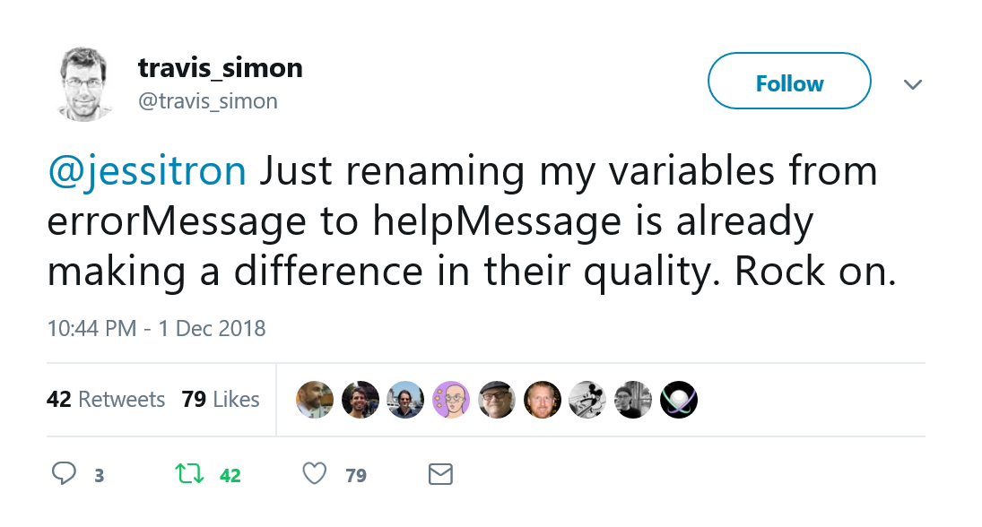
Notes:
This is about naming, and naming with empathy. An error message tells you what you did wrong. You’re wrong, you’re in error, you need to be corrected. A help message tells you what you need to do differently to succeed. It doesn’t carry a value judgement about what you did before. It might have been wrong. It might have been a perfectly valid attempt that sadly, the software can’t support. It might have been something people try to do all the time because the software makes it look like you can. Whatever. Let me help you carry on and move forward in doing your job. And while you might think, if I asked you whether it would change anything to rename errorMessage to helpMessage would anything change, nah, that couldn’t change anything, but Travis is telling you actually, it really did. It changed things.
You might be skeptical. But what’s the harm? Why not try a little empathy and see what improves?

Slide 27
Hard Working
It compiles, links, runs, and passes the tests
No warnings, no “you get one exception on startup, just hit Continue”, no stray files left behind
Tests are complete and well documented
I don’t have to be asked to do it right
It uses modern constructs or libraries or tools
I’m always learning; my code gets the benefit
But not tools for the sake of tools or for fun
Modern practices
Not just churning out code
Commitment to the future
My own ease
The team’s success
Notes:
This is the code of a hard working programmer who doesn’t do just the minimum to skate by. Who doesn’t just copy what was there before including the bad patterns and the bad code. Who takes the time to see if now is the time to change that thing that sort of grew organically and has become unwieldly and almost unmaintainable.

Slide 28
Choose to Show Positive Emotions
Your code will be easier to read and maintain
You will enjoy reading and maintaining it more
Your reputation will improve
Even if the code isn’t better
But it probably will be
Notes:
So sure, your code could show fear, selfishness, laziness, and arrogance
But why not show confidence, generosity, humility, and how hard working you are?

Slide 29
Call to action
Show your confidence
Clean up
Use a library
Make it right
Be generous and empathetic
Help users
Help your team
Name things well
You are going to show emotions in your code
They might as well be positive ones!
Notes:
… after all, we can’t avoid our own humanity. Thankyou.

